Slide 1
Paul among the philosophers

Slide 2
What Philosophers Did Paul Speak with?
Epicureans & Stoics
(While both philosophies were well known in the 1st century, Stoicism was dominant which is why Paul mainly addresses the Stoics.)

Slide 3
Where Did Paul Meet and Speak with Philosophers?
Answer One: Acts 17
Answer Two: Mars Hill (also known as the Areopagus)

Slide 4
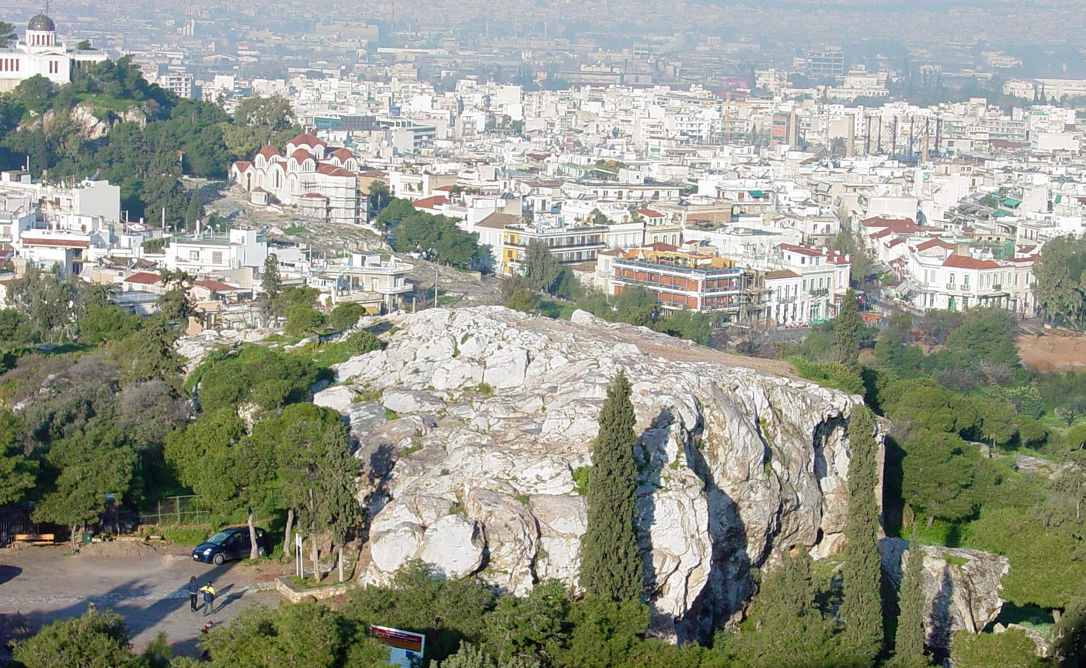
Mars Hill = Areopagus

Slide 5
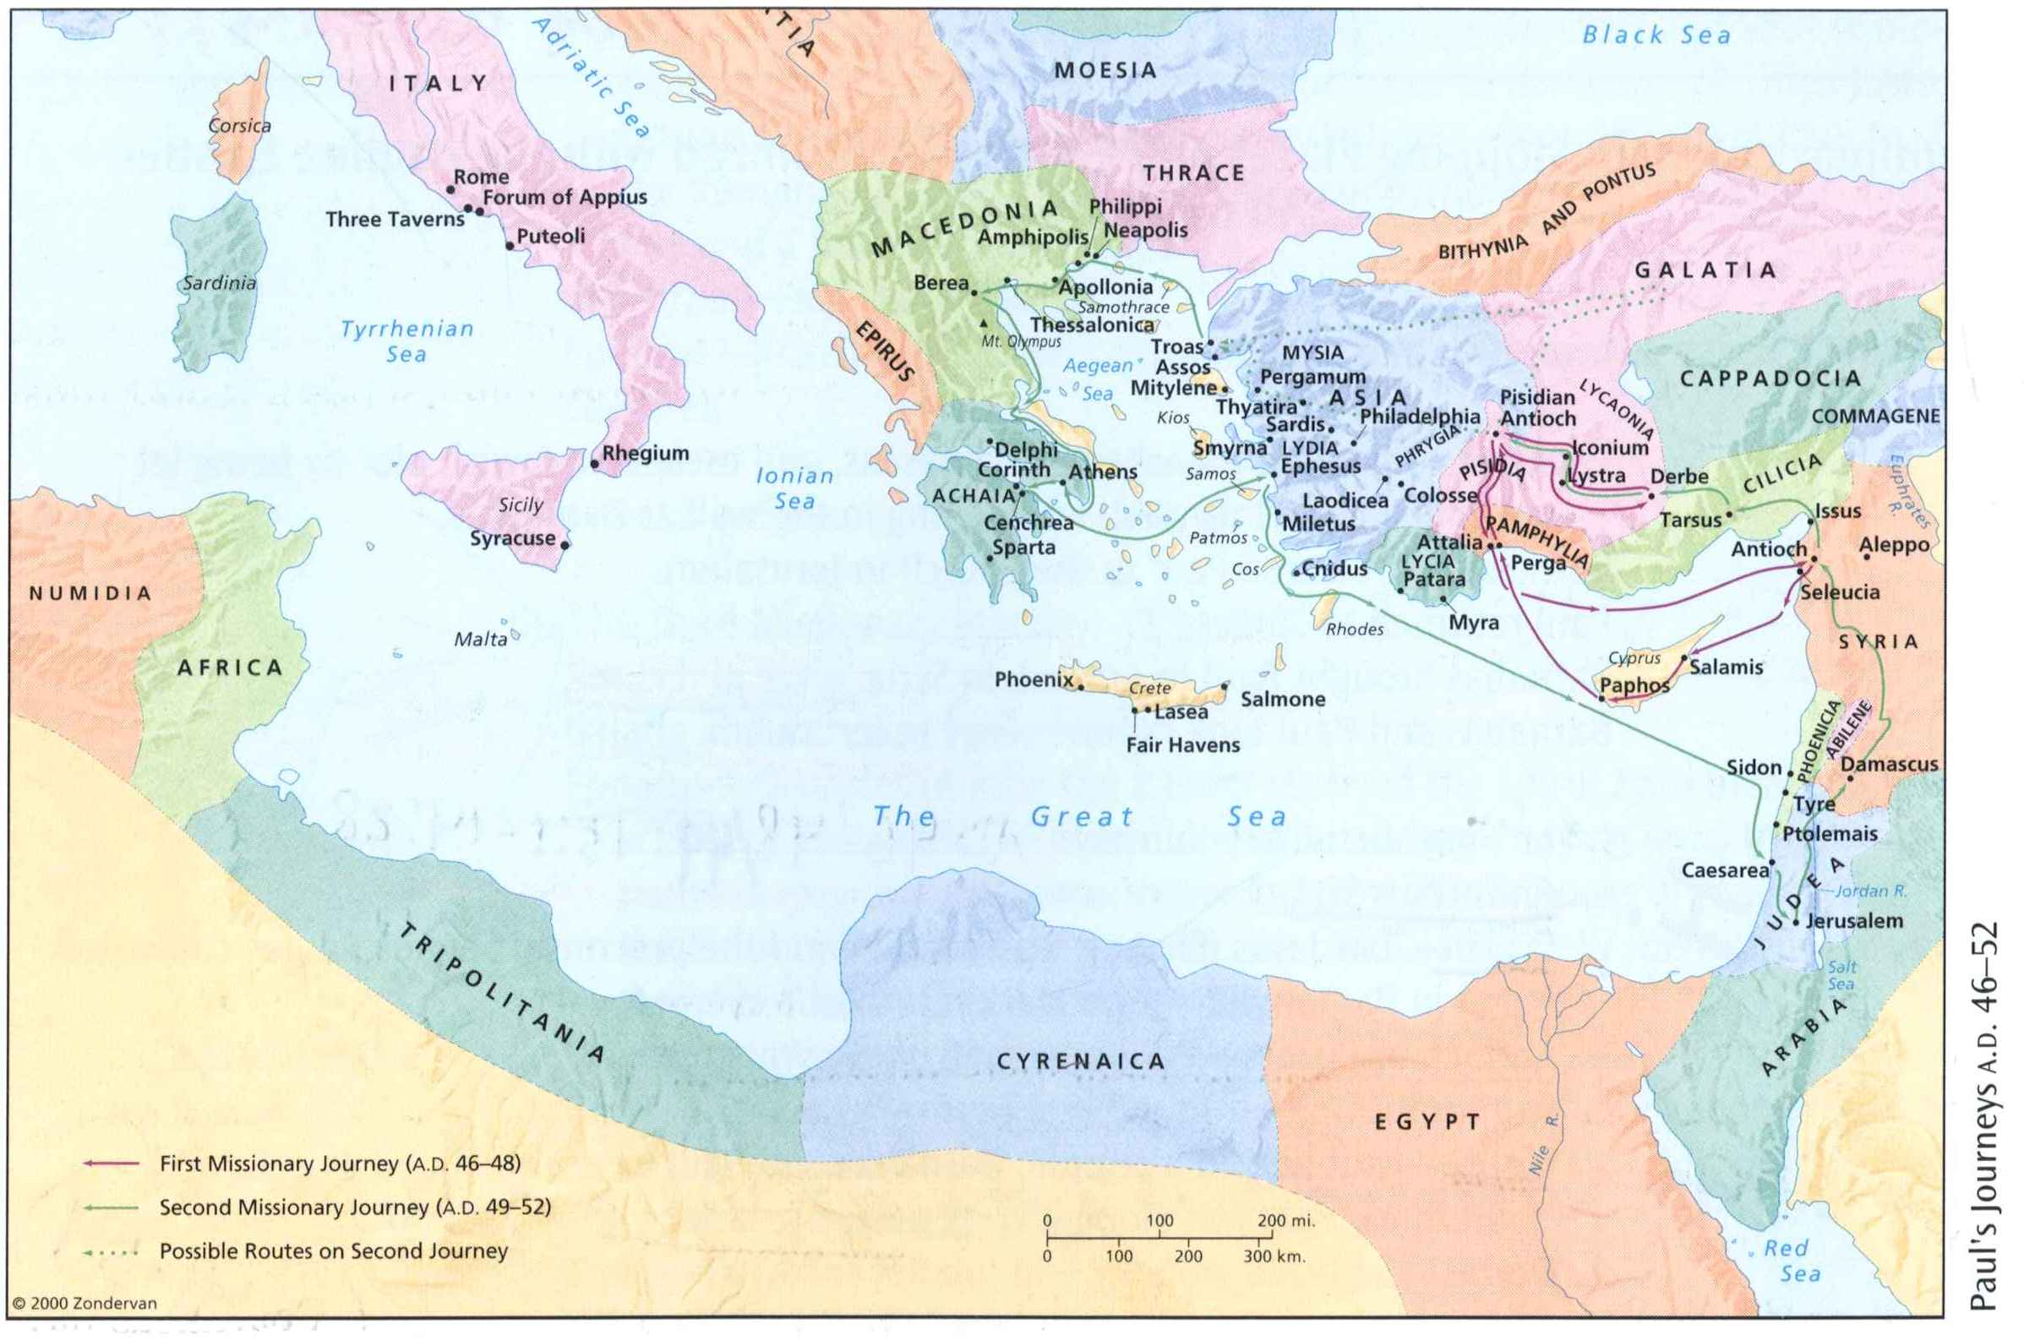
Where is Mars Hill? Athens

Slide 6
Quotable Quotes:
“Whatever things were rightly said among all men are the property of us Christians” –Justin Martyr
“Truth is one” –Clement of Alexandria
“Truth is truth, whether from the lips of Jesus or Balaam” –George MacDonald
“All truth is God’s truth” –Arthur Holmes

Slide 7
More Quotables: When Paul Witnesses to Stoics he actually quotes from ancient Stoic Philosophers
“In him we live and move and have our being”* –Epimenides (Acts 17:28a) [*God, in other words, is an immanent and omnipresent Spirit who causes and sustains our existence]
“We also are His offspring”* – Cleanthes (Acts 17:28b) [*We, in other words, are made in God’s image]

Slide 8
Myth …
Where was Paul in Acts 17?
ATHENS
Where was Paul in Acts 18?
CORINTH
Observation: In Athens Paul quoted pagan philosophers; in Corinth he “determined to know nothing but Christ and him crucified” (1Cor2:2)
CONCLUSION: Paul repented/rejected/repudiated what he did in Athens & so we today must have nothing to do with pagan literature or learning & only use the Bible in our thinking and evangelism

Slide 9

… Busted
If what Paul did in Athens was wrong, why then does Luke portray it as a resounding success (given the hardness of the soil) in Acts 17:32b, 34?
If what Paul did in Athens was wrong, why then does Paul keep right on doing it? I.e., Paul continues to quote other pagan thinkers, including later in 1st Corinthians where he supposedly rejected/repudiated doing this! The fact is that non-Christians often say things that are true.
“Bad company corrupts good morals” –Menander (1 Cor 15:33)
“All Cretans are liars”—Epimenides (Tit 1:12)

Slide 10
Paul is thus a model of:
___________________________ (fill in the blank*)
Being “all things to all men”
Being a Jew to the Jews (e.g., Acts 13)
Being a Greek to the Greeks (e.g., Acts 17)
Understanding the beliefs and world view of his audience
Building bridges for the Gospel on shared common ground (e.g., Scripture with Jews or General Revelation with Greeks)
the word you need to fill in the blank can be found in the textbook
(pp. 130, 133 in the 1st edition; or p. 177 in the 2nd edition)

